Slide 1
Purpose of this document
This document is meant as a “to-customer” document that can be presented and/or left behind for customer education purposes.
The objective is to increase customers’ trust and confidence in Azure with regards to regulatory compliance and security, and to educate about the process of moving workloads to the cloud and consulting Bank Negara Malaysia.
This document is not meant to replace the FSI checklists prepared by CELA or the content of the Trusted Cloud for Financial Services website. It is intended to summarize and complement the information from those sources in an easy presentable format to enable account teams to pro-actively (by scheduling education sessions and roundtables) and re-actively (by responding to customer requests) engage and educate customers with the support of the (yet to be appointed) Malaysia FSI Compliance Champion who will own and maintains the content of this document.
INTERNAL SLIDE – PLEASE DO NOT SHARE

Slide 2
Instructions
This deck is meant for a diverse audience. You may be presenting to Risk or IT-Risk stakeholders, or you may be presenting to IT, Security, Legal or Business stakeholders. Hence, the deck is not very targeted and rather a selection of slides that should be adjusted based on your respective intended audience, meeting purpose, meeting duration, etc.
Please go through the deck and hide or remove the slides that aren’t applicable and consider presenting additional content from the links in the References section, if needed.
After presenting to customers, please feel free to provide feedback so we can improve this document over time based your experience.
INTERNAL SLIDE – PLEASE DO NOT SHARE

Slide 3

Azure for Financial Services Malaysia Regulatory Compliance Guide 2021

Slide 4
Content
Compliance in the cloud
Steps towards compliance in Azure for Malaysian Financial Institutions
Assessment
Consultation of regulator
Deployment in Azure
Governance & monitoring in Azure
References

Slide 5

A secure and compliant foundation at global scale
Each physical datacenter protected with world-class, multi-layered protection
Microsoft Cyber Defense Operations Center
3,500+ full-time security professionals
6.5 trillion global signals daily
$1 billion annual cybersecurity investment
Cutting-edge operational security with restricted access, 24x7 monitoring and global security experts
With 66 regions, Azure has the largest geographical footprint of any cloud provider operating regions in 28 countries on all continents.
With 90+ compliance certifications, Azure has the deepest and broadest compliance coverage in the industry
160+ datacenters across the
planet
Global cloud infrastructure with custom hardware and network protection
https://infrastructuremap.microsoft.com
https://azure.microsoft.com/en-us/overview/trusted-cloud
Notes:
When we think about security, it starts with operational excellence from physical security to operational security to global cloud fabric that runs our clouds (Office365, Azure) and our security services.
The first side is the secure foundation of our cloud services. This is about how we operate our own cloud services, Azure, Office 365 and so forth. We have some of the world's best physical security, with fences and barbed wire and so on to provide secured building environments and within those buildings, secure server environments.
To enter a server environment, for example, a person would have to pass through multiple physical layers and provide multiple forms of identification. They would also be scanned for metal in their pockets to make sure that they are not bringing devices in to steal information. So, there's a great deal of physical security in place that we do on behalf of all of our customers in our cloud services and that make it possible for our customers to really leverage the investment that we've made in that respect.
Operational security. One of the ways this comes to life is in our continual testing of our services, making sure that that we're finding vulnerabilities faster than the hackers can. We have a big focus on red team, blue team exercises. If you're not familiar with those, the idea is that we have dedicated professionals whose job it is to be on the good side but act like hackers —they’re constantly trying to find ways to penetrate the services, find ways that real hackers might attack us so that we can shore up our defenses.
Another example of our operational excellence is around restricted access. When Microsoft employees need elevated access so that they can do maintenance on a service, or so they can investigate a customer support issue, they only have access to exactly the resources they need to access and for only exactly the amount of time that they need it. So, they have just in time and just enough access to do their work, and then they get out. They don't have any standing elevated access that allows them to view customer data.
And this is something, again, where we can make an investment at Microsoft that gets heavily leveraged because all of our customers benefit.
Lastly, customer controls are a huge important part of this. This is something that we get asked about a lot when we talk to customers about our cloud services. What are the things that I have at my control so that I can decide how I want to manage my data and access to it? Access controls, of course, are the very foundation of it. Multi-factor authentication for admins at customer sites who are in charge of operating Azure for that customer or operating Office 365. Having multi-factor authentication of course is a basic that we think is fundamental.
And lastly, network and distributed denial of service protection is in place for all of these services. We do basic protection to ensure our services work reliably, and Azure customers can take advantage of additional protection at the network layer to suit their needs.

Slide 6

Microsoft announces plans to establish its first datacenter region in Malaysia as part of “Bersama Malaysia” initiative to support inclusive economic growth
Kuala Lumpur, Malaysia – April 19 2021 – Microsoft Corp. today announced its “Bersama Malaysia” (Together with Malaysia) initiative, which marks a significant commitment to empowering Malaysia’s inclusive digital economy and advancing the nation’s digital transformation across the private and public sectors. As part of the plan, Microsoft will establish its first datacenter region in the country to deliver trusted cloud services locally, with world-class data security, privacy, and the ability to store data in-country.
“Bersama Malaysia” includes a commitment to skill an additional 1 million Malaysians by end of 2023, collaboration across public and private sectors and formation of a MyDigital Alliance Leadership Council
https://news.microsoft.com/en-my/2021/04/19/microsoft-announces-plans-to-establish-its-first-datacenter-region-in-malaysia-as-part-of-bersama-malaysia-initiative-to-support-inclusive-economic-growth

Slide 7
Azure has the deepest & broadest compliance coverage in the industry
ISO 27001:2013 ISO 27017:2015 ISO 27018:2014
ISO 22301:2012 ISO 9001:2015 ISO 20000-1:2011
SOC 1 Type 2 SOC 2 Type 2 SOC 3 CIS Benchmark
CSA STAR Certification CSA STAR Attestation CSA STAR Self-Assessment WCAG 2.0 (ISO 40500:2012)
Global
U.S. Government
FedRAMP High FedRAMP Moderate EAR ITAR
DoD DISA SRG Level 5 DoD DISA SRG Level 4 DoD DISA SRG Level 2 DFARS
DoE 10 CFR Part 810 NIST SP 800-171 NIST CSF Section 508 VPATs
FIPS 140-2 CJIS IRS 1075 CNSSI 1253
PCI DSS Level 1 GLBA (US) FFIEC (US) Shared Assessments (US) SEC 17a-4 (US) CFTC 1.31 (US) FINRA 4511 (US) SOX (US) 23 NYCRR 500 (US)
OSFI (Canada) FCA + PRA (UK) APRA (Australia) FINMA (Switzerland) FSA (Denmark) RBI + IRDAI (India) MAS + ABS (Singapore) NBB + FSMA (Belgium) AFM + DNB (Netherlands)
AMF + ACPR (France) KNF (Poland) European Banking Authority (EBA) FISC (Japan) HIPAA BAA (US) HITRUST Certification GxP (FDA 21 CFR Part 11) MARS-E (US)
NHS IG Toolkit (UK) NEN 7510:2011 (Netherlands) FERPA (US) CDSA MPAA (US) FACT (UK) DPP (UK) HDS (France)
Industry
Argentina PDPA Australia IRAP Unclassified Australia IRAP PROTECTED Canada Privacy Laws China GB 18030:2005 China DJCP (MLPS) Level 3
China TRUCS/CCCPPF EU EN 301 549 EU ENISA IAF EU Model Clauses EU—US Privacy Shield GDPR Germany C5 Germany TISAX
Germany IT-Grundschutz workbook India MeitY Japan CS Mark Gold Japan My Number Act Korea ISMS Netherlands BIR 2012 New Zealand Gov CIO Framework
Singapore MTCS Level 3 Spain ENS High Spain DPA UK Cyber Essentials Plus UK G-Cloud UK PASF
Regional
https://aka.ms/AzureCompliance
Notes:
Broadest, deepest
Understand needs,

Slide 8
Cloud Security = People + Process + Technology
People
Governance -Ownership Cloud Technology Risk Management Framework (CTRMF) and Cyber Risk Resilience Framework (CRRF)
Governance - Governance team TRMF and CRRF
Governance - Implementation team TRMF and CRRF
Process
Technology
Technology Operations Management - Technology Project Management
Data Centre Operations - Data center operations and capacity management.
System Development and Acquisition –Cloud Adoption framework Cyber Risk management framework
Technology Audit process
Third Party Service Provider Management - Outsourcing risk management.
Cryptography - Azure policy and controls.
Network Resiliency - Data center network reliability, scalability, and security
Access Control – Azure Policy, Azure AD Access control policy - physical and logical.
Cloud Service - Cloud Services Public cloud services adoption risk management. Azure Cloud Adoption Framework
Patch and End-of-Life System Management
Security of Digital Services
Cyber Risk Management
Cybersecurity Operations; Vulnerability Assessment and Penetration Testing (VAPT) activities.
Distributed Denial of Service (DDoS)
Data Loss Prevention (DLP)
Cyber Response and Recovery
Security Operations Centre (SOC)
Data center Ops Resiliency - Azure Well architected
Cybersecurity Operations; Vulnerability Assessment and Penetration Testing (VAPT) activities.
Cyber crisis management policies and procedures.
Internal Awareness and Training
Technology and cybersecurity awareness education.

Slide 9
Cloud security is a shared responsibility
Customer management
Data Classification and data accountability
Responsibility
On-prem
IaaS
PaaS
SaaS
Data Classification
and accountability
Client and end-point protection
Shared management
Identity and access management | End point devices
Identity and access management
Application level controls
Provider management
Physical | Networking
Network controls
Host Infrastructure
Physical Security
https://docs.microsoft.com/en-us/azure/security/fundamentals/shared-responsibility
Customer
Cloud Provider
Notes:
Microsoft cloud services are built on a foundation of trust and security. Microsoft provides you security controls and capabilities to help you protect your data and applications.
The security of your Microsoft cloud service is a partnership between You and Microsoft.
You own your data and identities and the responsibility for protecting them, the security of your on-premises resources, and the security of cloud components you control (varies by service)
-- alternate --
When customers leverage only on-premises IT infrastructure, they have complete responsibility to protect the data and to implement the controls necessary to be compliant with applicable regulatory standards. Customers using cloud services, lessen their burden (sometimes considerably) because the cloud represents a shared responsibility between the customer and the cloud service provider. As a cloud service provider, Microsoft provides the physical infrastructure and networking, so customers don’t need to spend resources building their own datacenter or setting up physical access controls.
Customer management of risk - Data Classification and data accountability
Shared management of risk - Identity and access management and End Point Devices
Provider management of risk – Physical and Networking
Under this shared responsibility model, Microsoft is partnering with organizations to help them protect their data and stay compliant with relevant regulations and standards when they use Microsoft Cloud services. Let’s take the example of NIST 800-53: In the standard’s latest iteration, there are 975 controls. 78 percent of those controls are Microsoft’s responsibility, while only 22 percent are the customer’s responsibility.
Even more compelling is that Microsoft not only takes care of its own responsibilities, but also provides customers with tools and features to help them cover theirs.

Slide 10




Microsoft Responsibilities - Azure
Compliance Certification and Auditing
Azure makes compliance certifications and attestations available to customers and potential customers
Azure makes compliance audit reports available for customers and potential customers
Azure ensures customer data is securely decommissioned using NIST 800-88 compliant protocols
Azure ensures that customer key vaults are logically isolated from each other
Key Vault is designed so that Microsoft does not have any standing access to the customer’s vault
Data protection
Azure manages anti-malware for PaaS services and offers Azure Antimalware for IaaS instances.
Azure performs scans for vulnerabilities on in-scope underlying infrastructure.
Azure ensures all network devices have applicable vendor-supplied security patches.
Threat protection
Azure employs boundary protection to control communications at external and internal boundaries
Azure implements network filtering to restrict incoming and outgoing traffic to trusted components
The Azure network is segregated to separate customer traffic from management traffic
Network security
Implements industry-accepted security configuration standards for systems in the Azure environment
Ensures only authorized personal are able to configure Azure platform security controls
Azure platform components are configured to log and collect security events.
Governance and Management
Physical access to Azure network hardware is tightly controlled by access lists, authentication, physical barriers to entry, and requirement for approval for access to equipment.
Azure implements and enforces monitoring physical access security for data centers.
Physical Security

Slide 11
Customer Responsibilities
Azure Service
Customer Action
Data classification & Accountability
Azure Information Protection
Ensure their solution and its data is securely identified, labeled, and correctly classified to meet any compliance obligation.
Azure Information Protection
Azure Role-Based Access Control (RBAC)
Multi-Factor Authentication
Define and document a User ID approval process, define least privileges, restrict access to classified data, provide separation of duties, revoke user access when no longer necessary.
Identity & access management
Data protection
Azure Key Vault
Azure Storage Service Encryption
Ensure strong cryptography and secure protocols are used to connect to their Azure environment. Manage cryptographic keys and documenting all related procedures.
Ensure anti-malware software is deployed on all systems DE commonly affected by malware. Customers may enable Azure Antimalware to leverage Azure's anti-malware protections.
Threat protection
Azure Security Center
Microsoft Antimalware for Azure
Network security groups
Azure Firewall
DDos Protection
Establish and implement configuration standards for use of Microsoft Azure networking controls.
Network security
Azure Security Center
Azure Sentinel, Azure Log Analytics
Azure Blueprints
Create, maintain, and enforce policies. Conduct required testing. Enforce configuration standards. Record and maintain logs of all access by users.
Governance and Management

Slide 12
Steps towards compliance in Azure for Malaysian Financial Institutions
2a. Notify BNM of intention to use cloud services
1. Conduct and document risk assessment as
outlined in RMiT S 10.49
3. Deploy in Azure
4. Govern and monitor in Azure
No
“Material Outsourcing
Arrangement”?
Yes
2b. Consult BNM for approval. If the outsourcing is of a "critical system," conduct and document additional risk assessment as outlined in RMiT S 10.51 & Material Outsourcing Guideline S 12

Slide 13
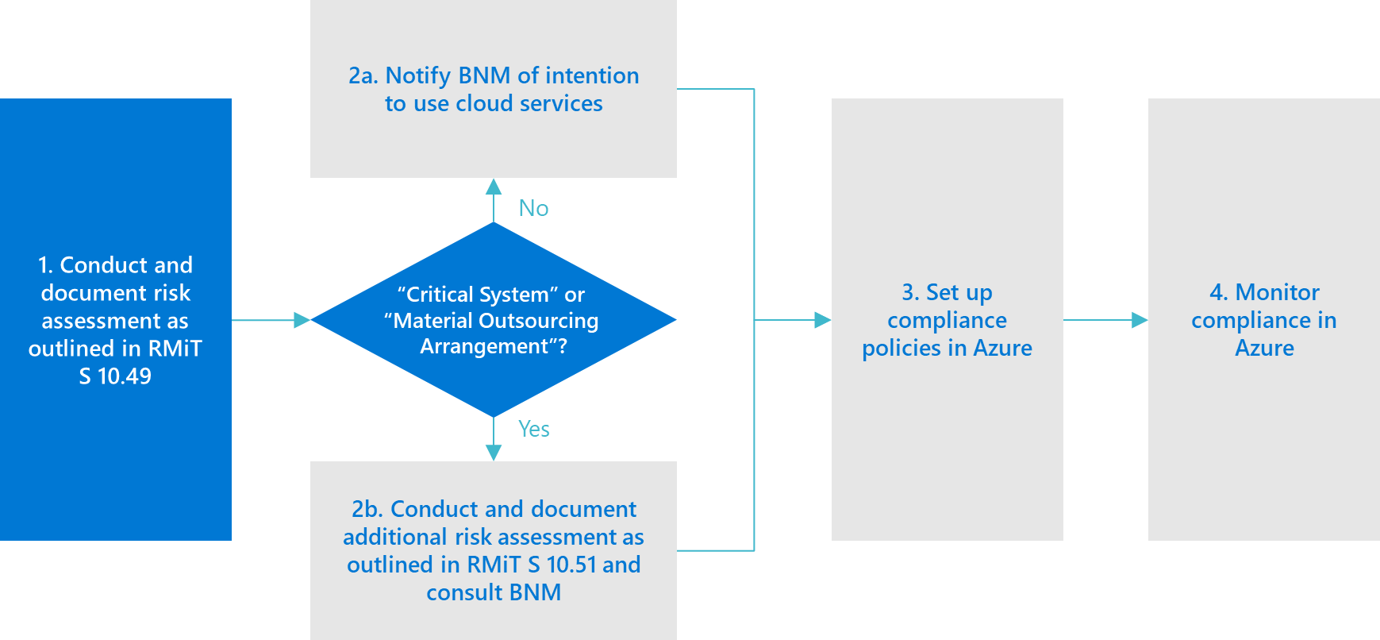
1. Conduct and document risk assessment as outlined in RMiT S 10.49

Slide 14

What are the sector-specific laws and guidelines that need to be considered?
Financial Services Act
Outsourcing Policy Document and FAQ
Risk Management in Technology (RMiT)
BNM Interoperable Credit Transfer Framework
Licensing Framework for Digital Banks
Financial institutions using Microsoft Cloud Services can feel confident that they can comply with BNM's RMiT and Outsourcing requirements (as well as ISO27001, PDPA, GDPR and PCI-DSS, among other standards and regulations).
Material Outsourcing Arrangements, including outsourcing of Critical Systems, require BNM approval. BNM’s intent is to ensure that the risks are properly addressed and managed.
The assessment and classification of IT projects as Critical System or Material Outsourcing Arrangement (according to RMIT and Outsourcing Guideline, respectively) as well as its overall risk assessment and due diligence are the responsibility and duty of the Financial Institution (FI).
Policies and guidelines are changing frequently in this space. Microsoft is working with customers and regulators around the world to respond. If you have questions about regulations and how they may apply to your use of Microsoft products and services, please reach out to your Account Executive.

Slide 15
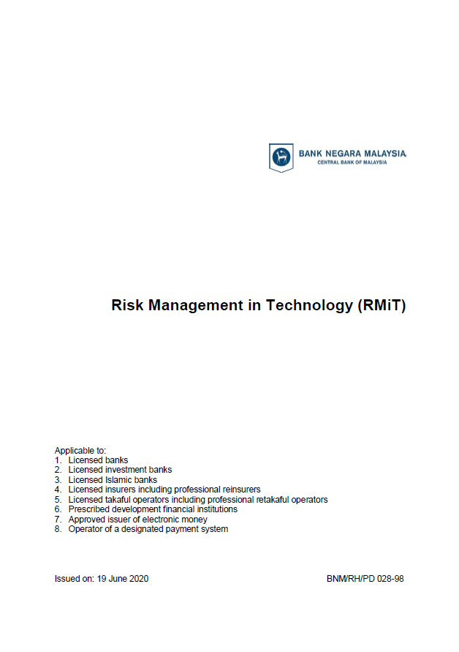
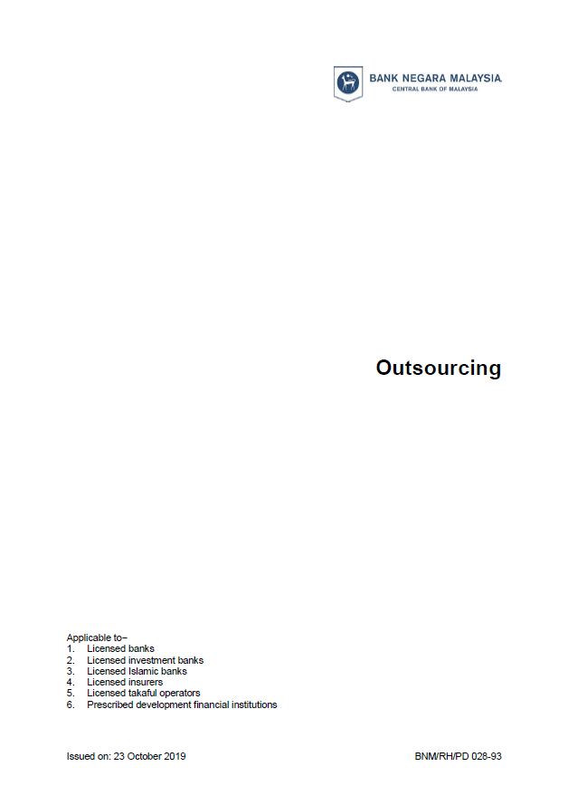
“critical system” refers to any application system that supports the provision of critical banking, insurance or payment services, where failure of the system has the potential to significantly impair the financial institution’s provision of financial services to customers or counterparties, business operations, financial position, reputation, or compliance with applicable laws and regulatory requirements;
“material outsourcing arrangement” refers to an outsourcing arrangement which−
(i) in the event of a service failure or security breach, has the potential to significantly impact the financial institution’s provision of financial services to customers, business operations, financial position, reputation, or compliance with applicable laws and regulatory requirements; or
(ii) involves customer information and in the event of unauthorised access, disclosure or modification, or loss or theft of the information, has a material impact on the customer or financial institution.
In assessing whether an outsourcing arrangement is material, a financial institution shall have regard to the factors set out in Appendix 3. For the avoidance of doubt, any arrangement involving internal control functions (i.e. risk management, internal audit and compliance) would generally be considered as a material outsourcing arrangement;
https://www.bnm.gov.my/standardsandguidelines

Slide 16
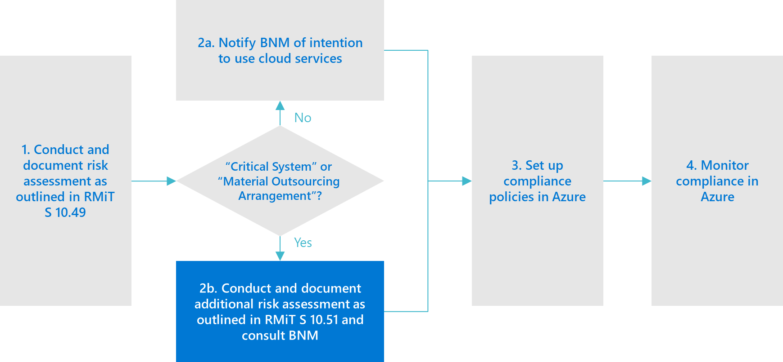
2b. Conduct and document additional risk assessment as outlined in RMiT S 10.51 & Material Outsourcing Guideline S 12, and consult BNM for approval, where required

Slide 17
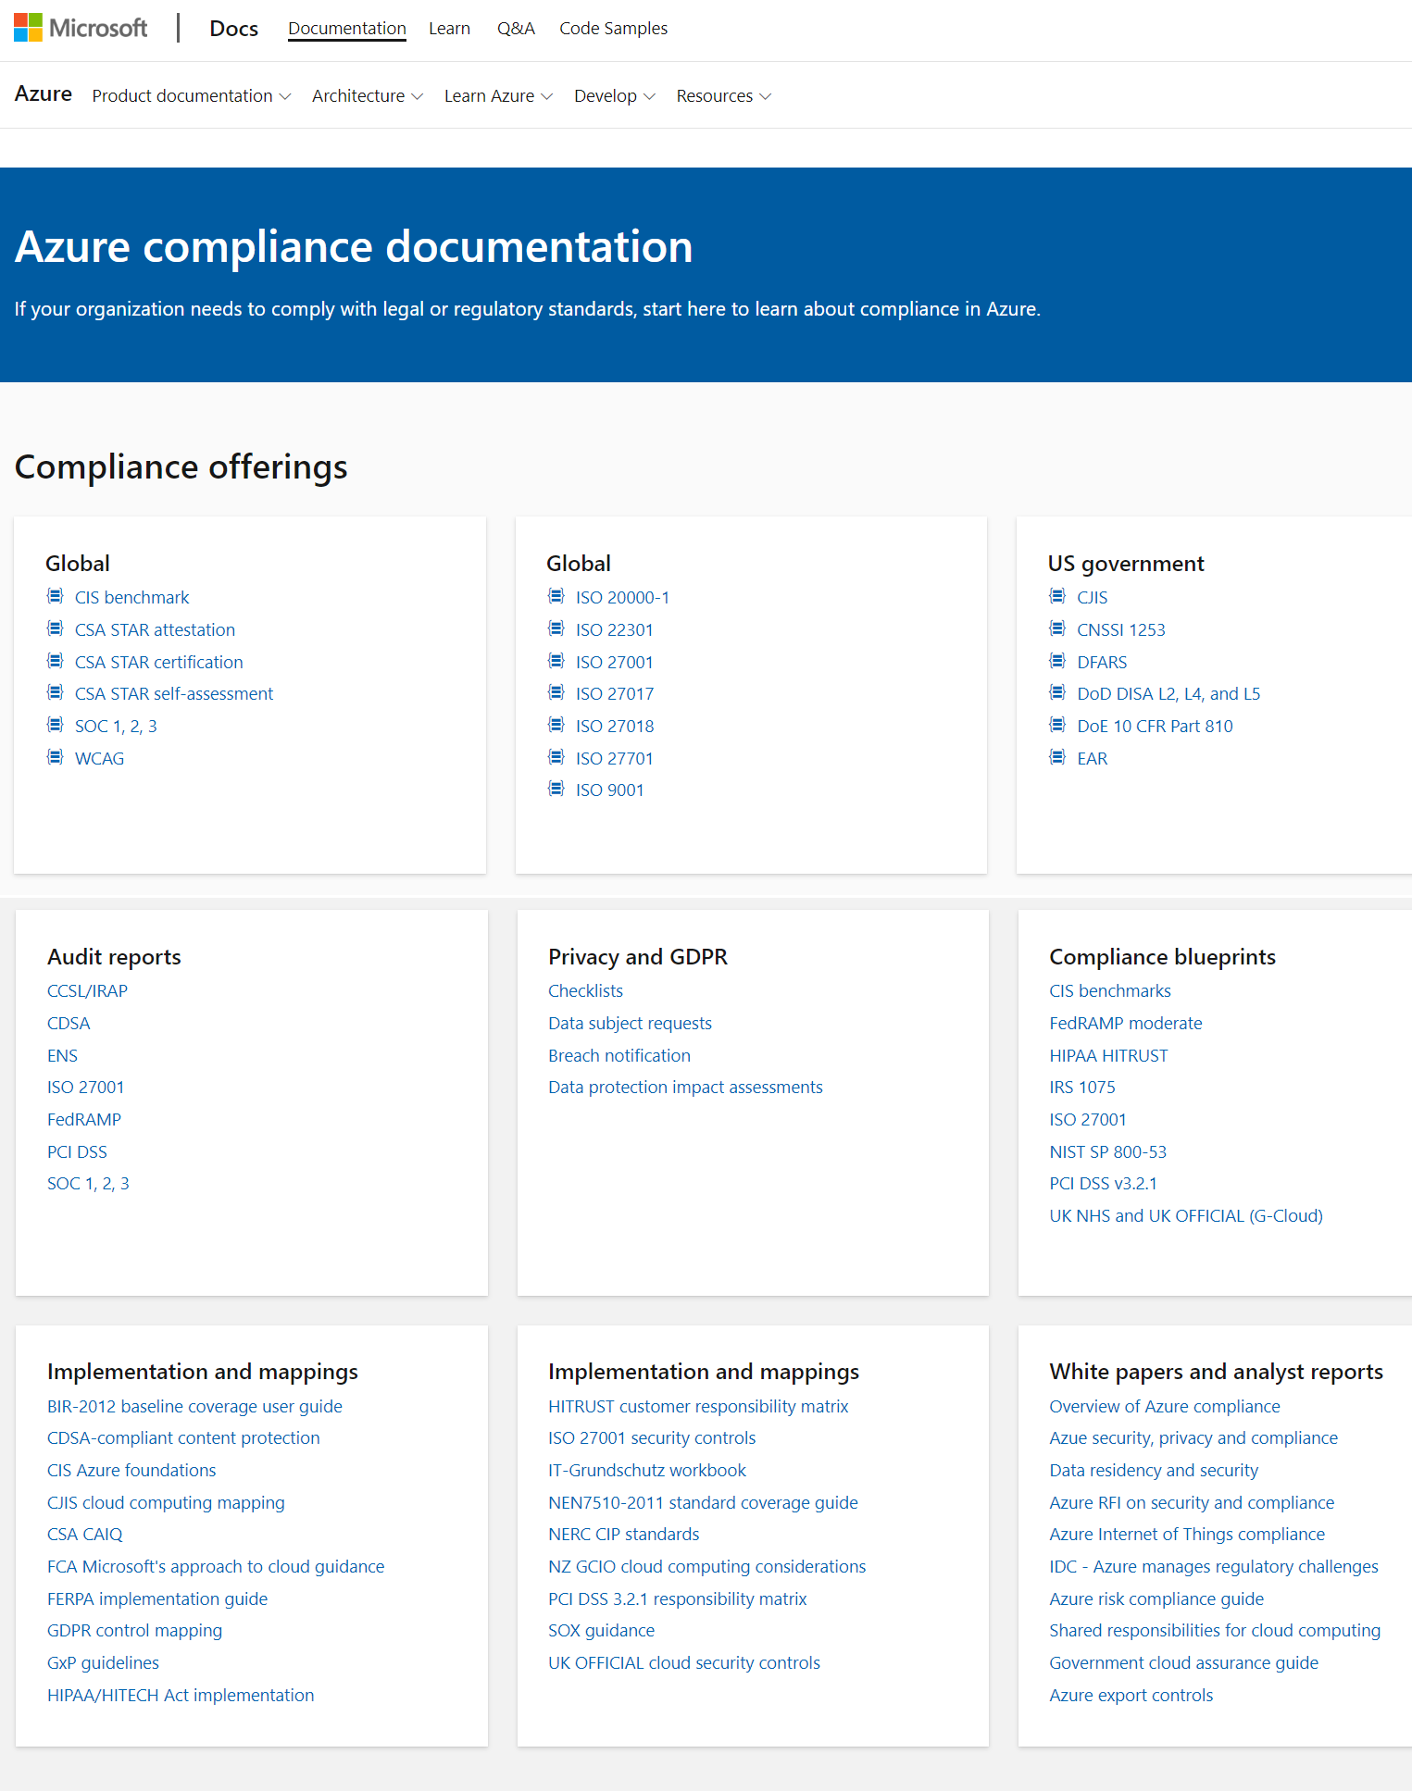
Azure Compliance Document Hub https://docs.microsoft.com/en-us/azure/compliance/
FI customers can download relevant audit reports from Microsoft for BNM submission.
Centralized resource for Azure compliance and privacy documentation
Detailed information on all 90 compliance offerings
Audit reports, control mappings, blueprints, and more
Learn more at www.microsoft.com/trust
Notes:
The Microsoft Trust Center is the primary centralized resource for customers to seek answers to the most common questions regarding privacy, security, compliance, and transparency, and other related helpful information. For example, customers can use the Cloud Services Due Diligence Checklist that provides a structure for an organization of any size and type to identify their own performance, service, data management, and governance objectives and requirements.
Additionally, the Trust Center links to detailed trust information on each of our cloud services.
The Trust Center is regularly updated with the latest answers, resources, and certifications.

Slide 18
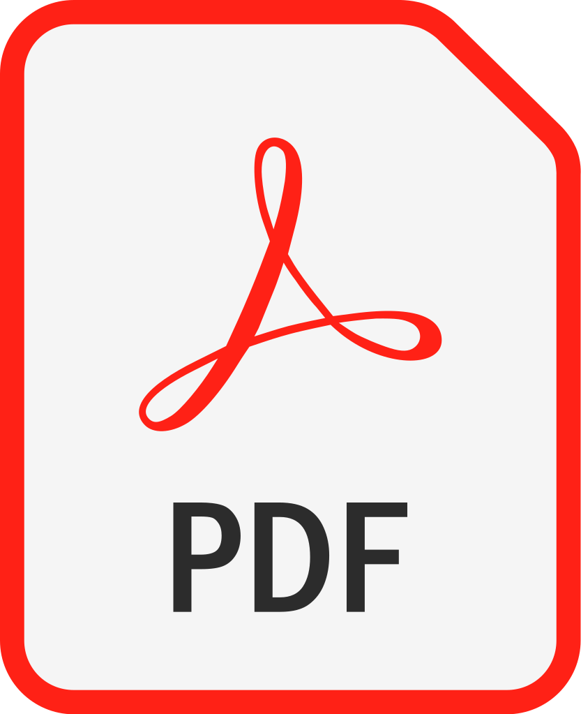
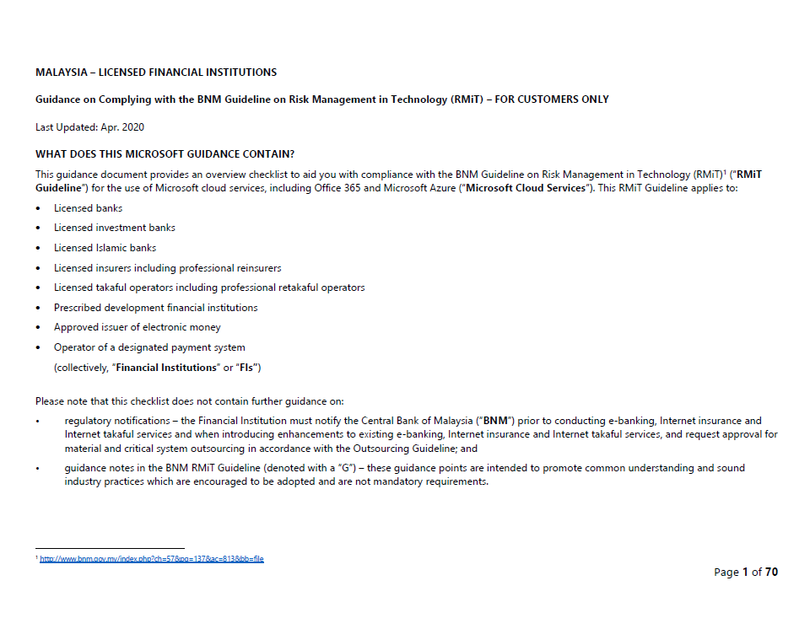
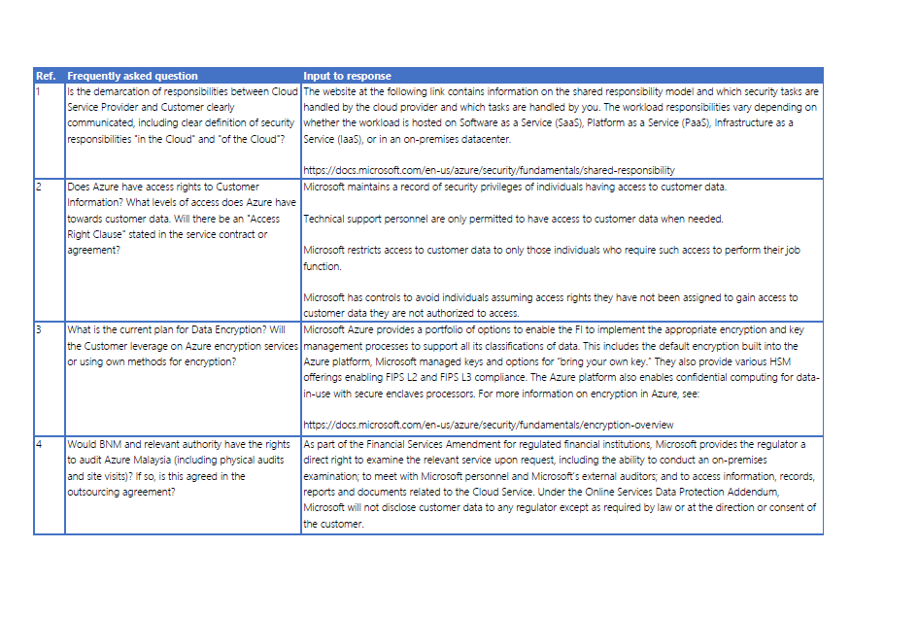
Guidance on Complying with the BNM standards and guidelines on Risk Management in Technology (RMiT)
Regulatory notifications – the Financial Institution must notify the Central Bank of Malaysia prior to conducting e-banking, Internet insurance and Internet takaful services and when introducing enhancements to existing e-banking, Internet insurance and Internet takaful services, and request approval for material and critical system outsourcing in accordance with the Outsourcing Guideline.
Microsoft provides guidance documents with an overview checklist to aid you with compliance with the BNM Guideline on Risk Management in Technology (RMiT) for the use of Microsoft cloud services.
Kindly ask your Account Executive to provide you with these guidance documents.
Full checklist
Frequently Answered Questions

Slide 19
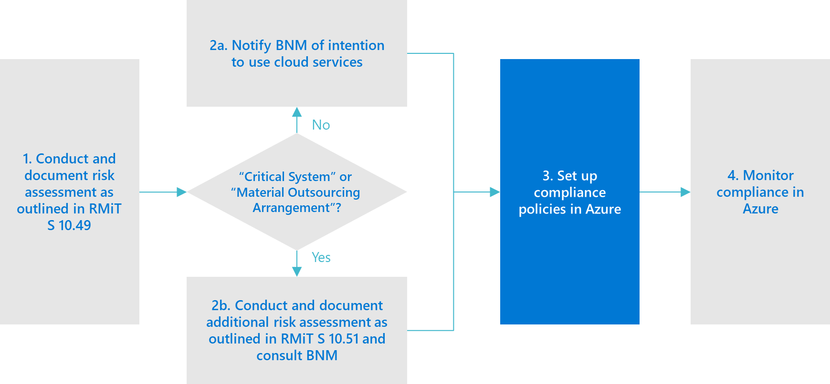
3. Deploy in Azure

Slide 20
Microsoft Cloud Adoption Framework for Azure
Templates
People
Process
Technology
Best practices
Documentation
Tools
Achieve balance
Align—business, people and technology strategy.
Achieve—business goals with actionable, efficient, and comprehensive guidance.
Deliver—fast results with control and stability.
Notes:
Started with notion that the value of cloud services (speed, agility, innovation, cost, security) is often negatively impacted by existing/legacy enterprise IT processes and practices (Legacy doesn’t work)
The Cloud Adoption Framework (CAF) is a set of documentation, implementation guidance, best practices and tools that aids in aligning strategies for business, culture, and technology to enable the desired business outcomes, faster and with confidence.
The Cloud Adoption Framework is proven guidance that’s designed to help you create and implement the business and technology strategies necessary for your organization to succeed in the cloud.
It provides best practices, documentation, and tools that cloud architects, IT professionals, and business decision makers need to successfully achieve their short- and long-term objectives.
By using Cloud Adoption Framework best practices, organizations are better able to align their business and technical strategies to ensure success.

Slide 21
Microsoft Cloud Adoption Framework for Azure
Proven business and technical guidance to help customers create and implement the business and technology strategies necessary to succeed in the cloud
Define strategy
Define business justification and expected outcomes
Plan
Align actionable cloud adoption plan to business outcomes
Ready
Prepare people, process and environment for change
Adopt
Migrate or Innovate
Implement desired changes across IT and business processes
Govern
Comply, control and secure
Manage
Operate and optimize
Learn more at : https://azure.microsoft.com/en-us/cloud-adoption-framework/
Notes:
<Key point>: Cloud Adoption Framework—modular phases of adoption.
As your organization evolves, the Cloud Adoption Framework adapts to your business needs.
Each module in the diagram is an iterative phase that advances your business through the complete lifecycle of cloud adoption.
Customers can choose the phase best-suited to their degree of cloud adoption maturity. The Cloud Adoption Framework offers a guiding methodology to cloud adoption, with specific approaches to overcoming common blockers to cloud adoption in each module, such as “Define Strategy,” “Plan,”, etc.
The Cloud Adoption Framework offers the enterprise a modular framework of how to incrementally onboard to the cloud.
Cloud adoption shifts how companies obtain, make use of, and lock down their technology resources.
And—this kind of modular framework flips the model of how enterprises operate:
Transitions organizations to need-based consumption of technology resources
Change from cap-ex (capital expenditure) to op-ex (operating expenditure) model
Cloud model assumes security, governance, cost-optimization, and hybrid cloud by default
Develop a future-ready workforce—developing and deploying cloud skill readiness organization-wide
As an organization progress through the Cloud Adoption Framework, what are the main goals of each methodology of “Define Strategy,” “Plan,” you can focus efforts on?
<Transition>: Now that we have taken look at the phases and modular approach, lets look at about some common business blockers that the Cloud Adoption Framework can help you resolve.

Slide 22
Enterprise-scale Critical Design Areas
Enterprise Enrolment and Azure AD Tenants
Identity and Access Management
Management Group and Subscription Organisation
Network Topology and Connectivity
Management and Monitoring
Business Continuity and Disaster Recovery
Security, Governance and Compliance
Platform Automation and DevOps
Learn more at : https://docs.microsoft.com/en-us/azure/cloud-adoption-framework/ready/enterprise-scale/design-guidelines#critical-design-areas

Slide 23

Azure Policy
Active control and governance at scale for your Azure resources
Enforcement and compliance
Enforce policies to help ensure cloud compliance and avoid misconfigurations.
Apply policies at scale
Reduce the time needed to audit your environments by having all your compliance data in a single place.
Remediate and automate
Minimize drift by configuring automated remediation tasks and alerts.
Notes:
Azure Policy sits at the core of Azure, giving you the ability to codify your company policies into the platform. Once core benefit is that, given the rate of innovation of Azure, any new service will be governed by Azure Policy from day 1.
There are essentially three kinds of policies:
Enforcement and compliance: Auditing is the one we recommend getting started with. This means that users can use Azure with no restrictions, but if somebody goes against policy you will be able to see the compliance state in an easy-to-use view. There is no need to run scripts every 24 hours to check the compliance status.
Turn on built-in policies or build custom policies for all resource types.
Real-time policy evaluation and enforcement
Periodic and on-demand compliance evaluation
VM In-Guest Policy
Apply policies at scale Enforcing policies, the next level, essentially sets guardrails. This means that if you have an enforced policy, users have to do it that way or they will get a deny error.
Apply policies to a Management Group with control across your entire organization.
Apply multiple policies and aggregate policy states with policy initiatives.
Exclusion scope
Remediate and automate: Remediation is the last type, where you can take resources that are non-compliant back to desired state. Imagine that you need to have monitoring in your VMs and there are multiple non-complaint resources. You can trigger a remediation policy that will append monitoring to those resources.
Remediate existing resources at scale .
Automate remediation resources at deployment .
Trigger alerts when a resource is out of compliance.

Slide 24
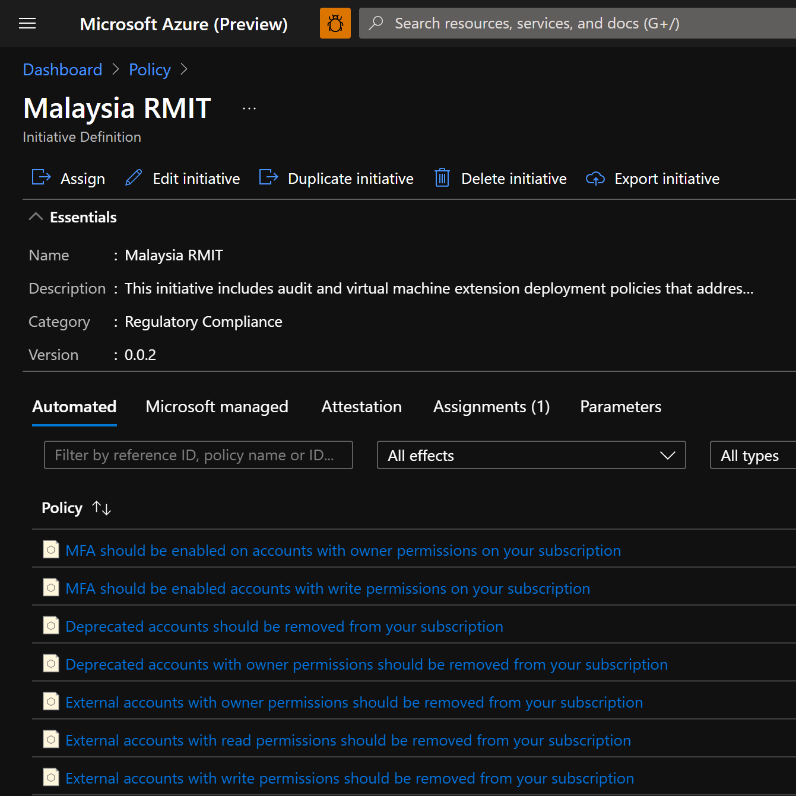
RMIT Azure Policy Initiative
A sample Azure policy initiative that would align with Malaysia RMIT guidelines.
FSIs can use this sample and assign it to their Azure management groups or subscriptions and then monitor compliance against the defined policies.
Steps:
Inside Azure Policy page, locate the ‘assignments’ tab.
‘Assign initiative’ and locate the RMIT initiative under the built-in types.
Customize the RMIT initiative in the ‘parameters’, ‘remediation’ and ‘non-compliance messages’ pages.

Slide 25
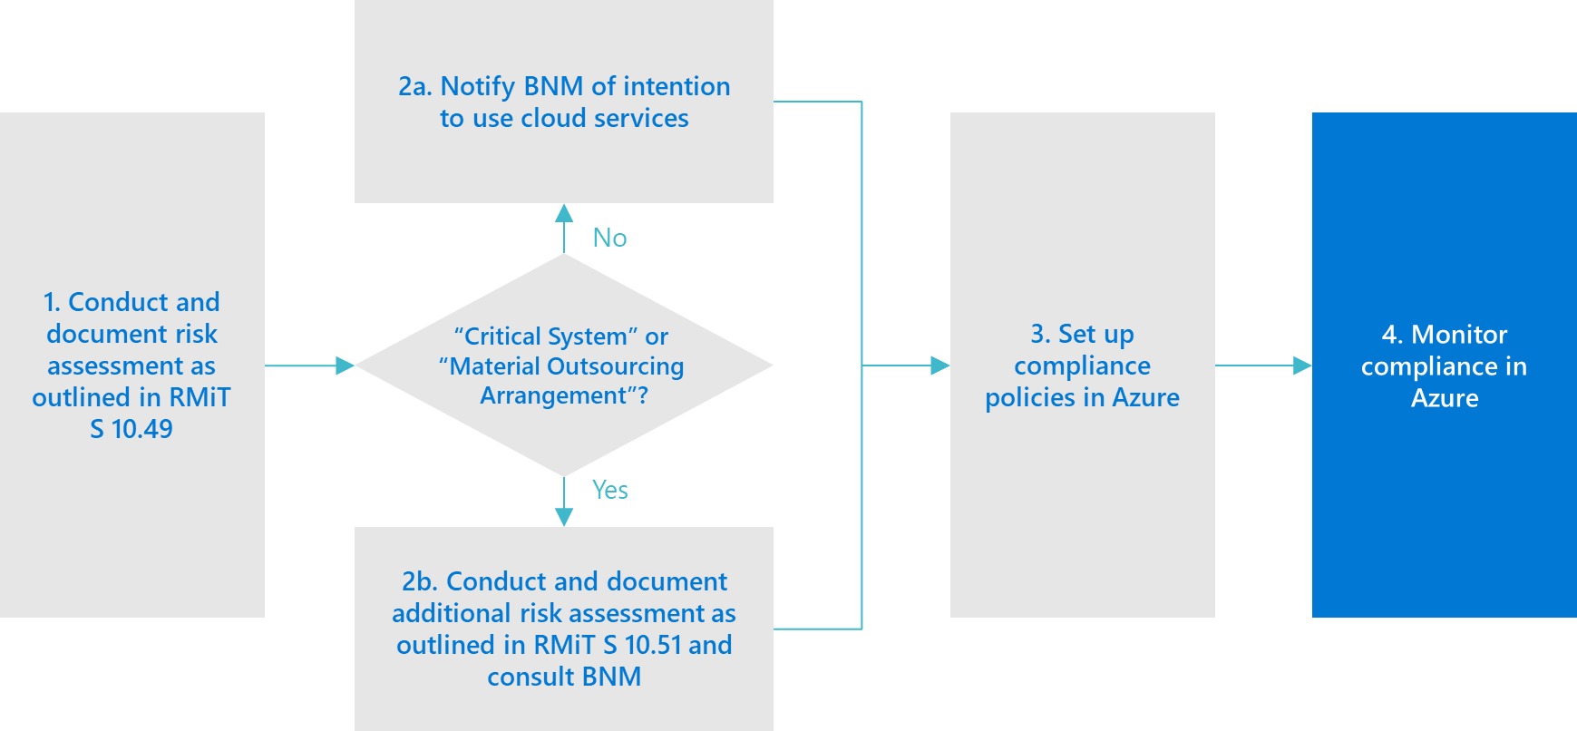
4. Govern and monitor in Azure

Slide 26
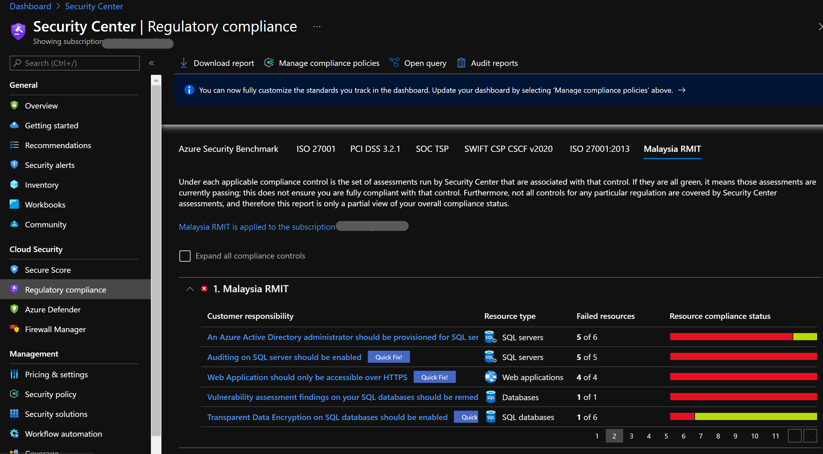
Azure Security Center
Azure Security Center is a unified infrastructure security management system that strengthens the security posture of your data centers and provides advanced threat protection across your hybrid workloads in the cloud - whether they're in Azure or not - as well as on premises.
One of its key features is to manage organizational security policies and assess compliance.
https://azure.microsoft.com/en-us/services/security-center/#documentation
Notes:
Azure Security Center provides one single pane of glass where you monitor your policies

Slide 27
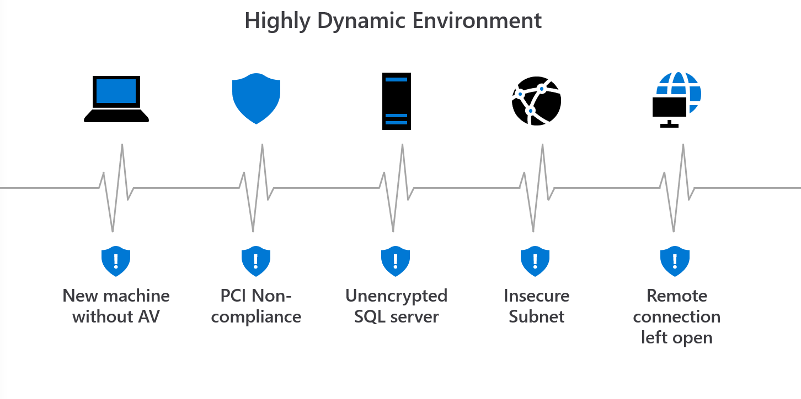
Manage organizational security policies and assess compliance in minutes
Manage security policies at an organizational level
Easily set security policies for subscriptions or management groups
Instantly understand your current policy compliance and review compliance overtime
Notes:
When you enable policies, Azure will ensure that your environment is secure
Azure will flag non-compliant parts

Slide 28




Azure Well-Architected Build and manage high-performing workloads
Build workloads with confidence with proven best practices
Design high-performing workloads using deep technical guidance
Optimize workloads with actionable focus areas
Azure
Well-Architected
Review
Reliability
Design
Principles
Azure
Advisor
Cost Optimization
Azure
Well-Architected
Framework
Operational Excellence
Performance Efficiency
Reference
Architectures
Documentation
Security
Partners, Support &
Services Offers
Learn More at : Microsoft Azure Well Architected Framework
Notes:
With the Microsoft Azure Well-Architected Framework you can BUILD workloads with confidence based on proven deep technical guidance, that is actionable and simple-to-use, and helps you identify areas of improvement, and where to focus your workloads optimization efforts.​
​
Well-Architected enables you to achieve three things…..
BUILD with confidence across all workload deployments and operations against.
DESIGN workloads using actionable and simple-to-use deep technical guidance.
PERFORM gap analysis to identify areas of improvement, and where to focus optimization efforts.
The framework is at the center of an ecosystem of best practices, documentation, assessments, reference architecture, and design principles. All this supported and amplified by Partners and Services offers to guide and assist you in improving your workloads’ quality.​
​
Azure Well-Architected Framework enables you to achieving your business objectives, operationalizing how to design, build, and optimize cloud solutions.​
Microsoft Azure Well-Architected Review provides evaluates workloads with gap analysis and identifies areas of where to focus your optimization efforts.​
Reference Architectures help you to build and deploy any workload to scale and meet your business needs.​
Design principles based on proven practices and design patterns from successful customer and partner deployments.​
Microsoft Partner & Service Offers support you—and help you build effective cloud solutions.​
But, building optimized workloads is a shared responsibility.

Slide 29
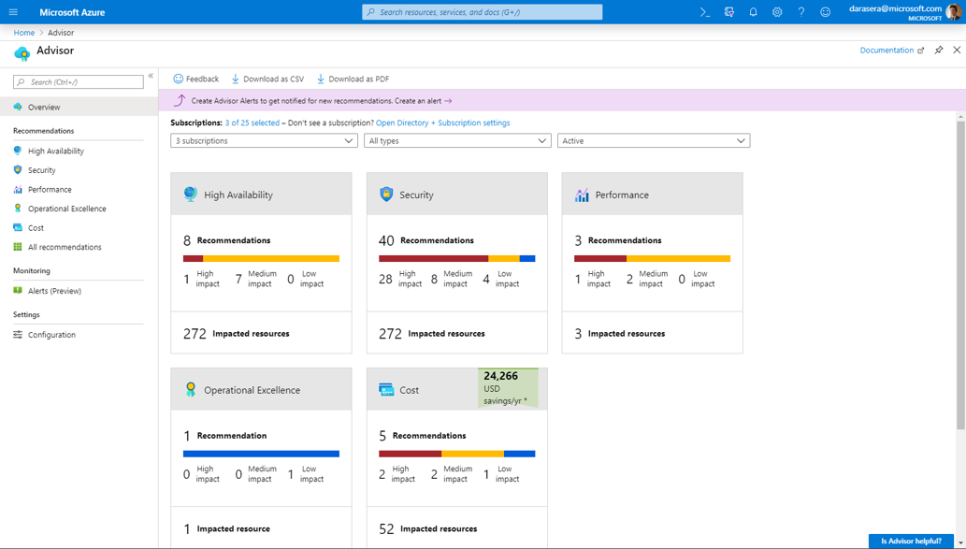
Azure Advisor
Practical recommendations based on your usage and configurations, such as:
Create Azure Service Health alerts.
Delete and re-create your pool to remove a deprecated internal component.
Repair invalid log alert rules.
Design your storage accounts to prevent reaching the maximum subscription limit.
Azure.com: aka.ms/advisor Tool: aka.ms/azureadvisor Documentation: aka.ms/docs/advisor
Notes:
Let’s start with Azure Advisor. This tool analyzes your configurations and usage telemetry and offers personalized, actionable recommendations to help you optimize your Azure resources.

Slide 30
Next Steps
Demo of Microsoft Azure’s capabilities supporting Banks in complying with RMIT
Dedicated timeboxed sandpit environment for the Bank’s to explore and verify
Discovery and assessment of the Bank’s infrastructure and application, and their cloud-readiness
Consider involving a third-party Risk Assurance Advisory partner for a pre-implementation review

Slide 31
References
General Assurance Resources
Trust center - https://www.microsoft.com/en-us/trust-center
Service Trust Portal (STP) – https://servicetrust.microsoft.com/
Documentation & training on how Microsoft operates controls – https://docs.microsoft.com/compliance
Downloadable Audit reports on STP – http://aka.ms/AuditReports
Security FAQs and whitepapers on STP – http://aka.ms/CloudSecurity
Online Services Terms – http://aka.ms/MicrosoftOST
Data Center Threat Vulnerability Risk Assessment (TVRA) information – http://aka.ms/tvra
Modern Cloud Risk Assessment presentation deck and internal training/readiness video
TruSight Independent Assessment Reports – external link
Law Enforcement Requests (LER) – https://www.microsoft.com/en-us/corporate-responsibility/lerr/
Risk Assessment and Compliance Guide for Financial Institutions in the Microsoft Cloud – https://azure.microsoft.com/mediahandler/files/resourcefiles/risk-assessment-and-compliance-guide-for-financial-institutions-in-the-microsoft-cloud-/Risk_Assessment_and_Compliance_Guide_for_Financial_Institutions_in_the_Microsoft_Cloud.pdf
Regional Regulatory Guidance
Regional FS Compliance Checklists – http://aka.ms/ComplianceGuides
Regulatory Compliance Site for Asia (with checklists): https://www.microsoft.com/en-sg/apac/trustedcloud/default.aspx

Slide 32
References
Regulatory Standards & Guidelines
Risk Management in Technology (RMiT) – https://www.bnm.gov.my/documents/20124/963937/Risk+Management+in+Technology+%28RMiT%29.pdf
Outsourcing Policy Document – https://www.bnm.gov.my/documents/20124/938039/PD_Outsourcing_20191023.pdf
Outsourcing FAQ – https://www.bnm.gov.my/documents/20124/938039/FAQ_Outsourcing_20191023.pdf
Financial Services Act – https://www.bnm.gov.my/standardsandguidelines
Interoperable Credit Transfer Framework (ICTF) – https://www.bnm.gov.my/-/interoperable-credit-transfer-framework-ictf-3
Licensing Framework for Digital Banks – https://www.bnm.gov.my/documents/20124/938039/20201231_Licensing+Framework+for+Digital+Banks.pdf
Regional Regulatory Guidance
Microsoft Cloud Adoption Framework for Azure – https://aka.ms/adopt/overview
Microsoft Azure Well Architected Framework – https://aka.ms/wellarchitected/framework
Financial Services Industry
Webinars – https://microsoftevent.eventbuilder.com/MicrosoftFinancialServicesCustomerCompliance
Compliance Program – https://www.microsoft.com/en-us/download/details.aspx?id=55332

Slide 33
References
Azure & M365 Specific Guidance
Audit Videos – http://aka.ms/auditvideos
Self-paced Learning Path - https://aka.ms/auditlearn
Compliance Manager – http://aka.ms/compliancemanager/
Azure blogpost – https://azure.microsoft.com/en-us/blog/azure-resources-to-assess-risk-and-compliance/
Azure security best practices – https://docs.microsoft.com/en-us/azure/security/fundamentals/best-practices-and-patterns
Azure security benchmark (blog) – https://www.microsoft.com/security/blog/2020/01/23/azure-security-benchmark-90-security-compliance-best-practices-azure-workloads/
Virtual Data Center Tour: https://news.microsoft.com/stories/microsoft-datacenter-tour/
Data portability, exit planning & concentration risk
Whitepaper and blogpost on concentration risk
Whitepaper and customer-ready presentation on exit planning
Blogpost on hybrid and multi-cloud deployment models
Recent Developments: Privacy & Schrems-II
Blogpost on Schrems-II of 19 November 2020
Updated Data Protection Addendum (DPA) of 9 December 2020 (additional safeguards)
Customer community call (February 2021)

Slide 34
Thank you

Slide 35






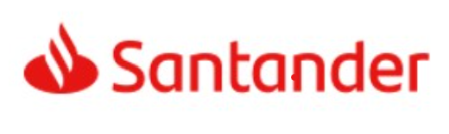
Microsoft is at the forefront of innovation in financial services
Strategic partnership announcements
>95%
of Fortune 500 companies use Azure
Aladdin is moving to Azure
We worked with Microsoft to ensure that its cloud technology meets our expectations for security.
Enterprise data lake on Azure for regulatory, risk & compliance management
of GSIFIs have signed Azure production cloud terms
>85%
We are building on the industry’s leading cloud platform in terms of innovation, technology, security and regulatory compliance
Implemented a Zero Trust strategy using Microsoft 365 technologies
Technology is a key enabler to the success of our business and Microsoft is a strong partner who will help us achieve our vision.
Notes:
The ecosystem keeps transforming.
Microsoft is an active partner with customers like UBS, ABN Amro, BlackRock, NAB, BofA, Mastercard, Santander and SWIFT
A NYT times article described how BlackRock, one of the world’s largest asset managers, transformed themselves, “from a bond shop catering to pension funds and insurance companies into an asset-gathering machine that uses advanced technology to reimagine how investors buy, sell and assess the risks of a wide variety of securities.”
Lou Kerner, a prominent venture capitalist, describes the convergence of many non-information technology companies becoming information technology companies as such, “Just like every successful company started using electricity, and every successful company started using the telephone, every successful company is obviously deeply engaging with software. The winners and the losers in every industry are increasingly being determined, as in Blackrock’s case, by those companies most adept at imagining, developing and deploying software”.
BlackRock and Microsoft form strategic partnership to host Aladdin on Azure as BlackRock readies Aladdin for next chapter of innovation – Stories
NAB and Microsoft sign five-year multi-cloud partnership to boost resilience, speed and innovation - Microsoft News Centre Australia
UBS uses the Microsoft Cloud to save costs and improve its services
Santander partners with Microsoft as a preferred strategic cloud provider to enable the bank’s digital transformation - Centro de noticias

Slide 36

UBS taps the cloud to power critical workloads
‟
With Microsoft Azure, we are building on the industry’s leading cloud platform in terms of innovation, technology, security and regulatory compliance, which is very important as a Swiss financial institution.”
— Paul McEwen, Group Head of Technology Services, UBS
Notes:
Key points:
Customer profile: Headquartered in Zurich, Switzerland, UBS is the world’s largest and fastest-growing wealth manager, providing financial advice and solutions to wealthy, institutional, and corporate clients worldwide. Present in all major financial centers, UBS has offices in 54 countries and employs approximately 60,000 people. | www.ubs.com
Challenge: Recognizing the tremendous transformation taking place in the financial services industry, UBS was looking to power its digital transformation, aiming to reduce dependency on legacy technology, find new ways to use digital channels, and rethink how its businesses and people work. They searched for a partner that could deliver all the advanced technological and economic benefits of cloud technology.
Solution: The financial giant selected Microsoft Azure to power its risk-management platform, technology that requires enormous computing power, to run millions of calculations daily on demand. Key to UBS’s move to Azure was a significant focus on regulatory compliance. The Microsoft Financial Services Compliance program—which allows firms and regulators to deeply examine Microsoft cloud systems, services, and processes—provides transparency into Microsoft cloud operations. This ensures UBS and regulators that Microsoft has taken the proper steps to secure data and mitigate risk.
Benefits: UBS has seen real results: speeding calculation time by 100 percent, saving 40 percent in infrastructure costs, gaining nearly infinite scale within minutes. All this means the firm can have more working capital on hand and employees can make quicker, more informed decisions for their clients. In terms of UBS’s strategic journey to the cloud, the risk platform is just the first step. UBS is actively partnering with Microsoft for opportunities to move more business applications to the Azure cloud.
Additional information: https://enterprise.microsoft.com/en-us/articles/industries/banking-and-capital-markets/ubs-taps-microsoft-cloud-power-business-critical-tech/
https://www.youtube.com/watch?v=p-kshCRDOCs&feature=youtu.be

Slide 37


Deutsche Börse Group moves to the cloud with confidence
‟
We were also impressed by Microsoft’s transparency, audit measures, regulatory compliance support and overall willingness to meet our needs—performed as part of Microsoft’s Financial Services Compliance Program.”
— Frank Fischer, Chief Security Officer and Head of Security, Deutsche Börse Group
Notes:
Key points:
Customer profile: Deutsche Börse Group (DBG), is a marketplace organizer for the trading of shares and other securities. It is also a transaction services provider. Based in Frankfurt, DBG is a leading stock exchange in Germany and one of the largest exchange organizations worldwide, with offices in more than 20 locations/ More than 3,200 employees service customers in Europe, the United States, and Asia. Website: http://deutsche-boerse.com/dbg-en/
Challenge: DBG wanted to undergo digital transformation to transform the way they work. They wanted their employees to become more productive, and grow with the demands of the market. They needed to do this while meeting strict industry regulations in Germany.
Solution: Microsoft satisfied DBG’s concerns about how it controls access to data and change management of automated processes, and did so through a deep examination of the features, such as Customer Lockbox and the capabilities of Office 365. Microsoft’s innovative approach to helping customers move to the Microsoft Cloud, while also meeting their regulatory obligations, including the Financial Services Compliance Program, gave DBG confidence in this move.
Benefits: DBG could modernize their business operations, while meeting stringent financial regulatory requirements in Germany, which has one of the most sophisticated regulatory systems in Europe.
Supporting details:
“Microsoft satisfied DBG’s concerns about how it controls access to data and change management of automated processes, and did so through a deep examination of the features, such as Customer Lockbox and the capabilities of Office 365.” — Frank Fischer, Chief Security Officer and Head of Security, Deutsche Börse Group
Speaker Guidance:
Key Message: DBG underwent a digital transformation by using Microsoft Office 365, while meeting strict industry regulations in Germany. Microsoft’s Financial Services Compliance Program helped them achieve their goals of modernizing their business.
Additional information: https://blogs.office.com/2017/03/06/moving-to-the-cloud-with-confidence-deutsche-borse-group-chooses-office-365/?ms.o365url=dbg

Slide 38

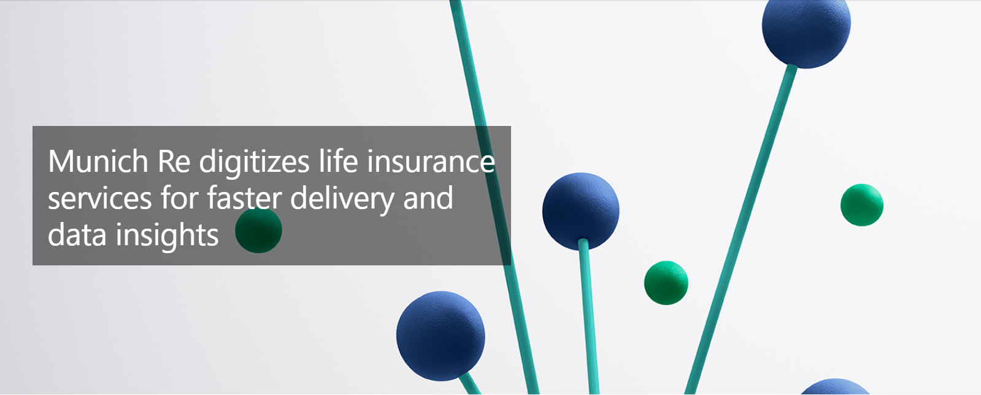

Munich RE moves to the cloud with trust.
We chose Azure because we were confident in its security and compliance features, and we trust the expertise of Microsoft as a cloud provider.”
— Lutz Küderli, Head of Digital Services for Life and Health
‟
Notes:
Key points:
Challenge: The life insurance sector has traditionally relied on manual and paper-based processes. Looking to deliver its expertise built up over decades in new and innovative ways, Munich Re wanted to move data and processes to the cloud to increase efficiency, gain new insights, and give its clients a digital advantage.
Solution: Munich Re decided to use the Microsoft Azure cloud platform to build its MIRA Digital Suite containing a range of new services for insurers and physicians. Munich Re extracts the data from Azure Cosmos DB and analyzes it in Azure SQL Database, allowing clients to gain the advanced insights needed to improve products and services.
Benefits: In digitizing the process of receiving reports from physicians, Munich Re has reduced a week-long process to just two days – only five minutes of which are spent by physicians filling out forms, which means more time with their patients, and with a 90 percent reduction in time for underwriters. The company also cut the claims management process in half, from 200 days to 100 days.
More Information: https://customers.microsoft.com/en-us/story/836291-munich-re-insurance-azure-cosmos-db

Slide 39
Enterprise-Scale?
Enterprise-scale is an architecture approach and reference implementation that enables effective construction and operationalization of landing zones on Azure, at scale and aligned with Azure Roadmap and Cloud Adoption Framework.
Authoritative Provides holistic design decision framework for Azure Platform.
Proven
Based on success of large-scale migration projects at-scale.
Prescriptive Apply this on "Monday Morning" in customer environment.
Enterprise-scale Architecture:
Enterprise-scale design principles: Principles to help/guide you customize the design.
Enterprise-scale design guidelines: Guidelines (decisions and recommendations) for the 8 components of the enterprise-scale architecture
Enterprise-scale Implementation guide: The way you create those things using reference implementation in GitHub and the deployment pipeline
Enterprise-scale reference Implementation:
Enterprise-scale foundation: A reference implementation of shared services containing network, security, identity, governance services required to construct and operationalize an enterprise-scale landing zone
Enterprise-scale landing zone(s): A reference implementation of a workload environment conforming to the enterprise-scale architecture (opinionated way to implement, code)
Notes:
Enterprise-scale comes in two buckets
The Architecture – What must be true? This is our Microsoft opinion on what should be done based on really world work with our strategic customers.
The reference implementation – This is a first partner example on how this could be implemented. You do not have to use this reference implementation if you are following the design guidelines and principles.
During our customer pilots we plan to validate both if possible but he priority in the architecture.

Slide 40
Enterprise-scale Design Principles
Enable Autonomy for Innovation and Transformation
Security and Compliance By-Default
Governance At-Scale with Sustainable Cloud Engineering
Subscription Democratisation
Policy Driven Governance
Single Control and Management Plane
Application Centric and Archetype-Neutral
Azure Native Design and Platform Roadmap Alignment
Learn More at : https://docs.microsoft.com/en-us/azure/cloud-adoption-framework/ready/enterprise-scale/design-principles
Notes:
Subscriptions should be used as a unit of management and scale aligned with business needs and priorities.
Azure Policy should be used to provide the “guard-rails” and ensure the continued compliance of the customer platform and applications deployed onto it, whilst also providing application owners sufficient freedom and a secure unhindered path to cloud.
The “North Star” architecture should not consider any abstraction layers such as customer developed portals or tooling and should provide a consistent experience for both AppOps (centrally managed operation teams) and DevOps (dedicated application operation teams).
The “North Star” architecture should focus on application centric migrations and development rather than a pure infrastructure “lift and shift” migration (i.e. movement of virtual machines) and should not differentiate between old/new applications or IaaS/PaaS applications.
The North Star architecture strongly advocates the use of native platform services and capabilities wherever possible, which should be fully aligned with Azure platform roadmaps from the offset to ensure new capabilities are swiftly made available within customer environments.

Slide 41
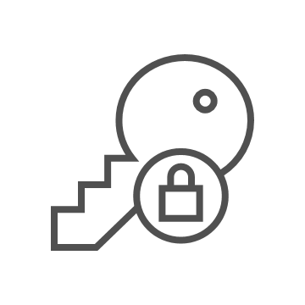
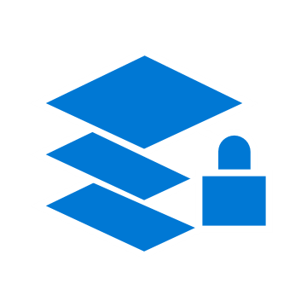
Azure Blueprints
deploy and update cloud environments in a repeatable manner using composable artifacts
Role-based access controls
Policy Definitions
Subscription A
ARM Templates
Azure Blueprints
Subscription B
Subscription C
…
compose
manage
scale
Notes:
Laura

Slide 42
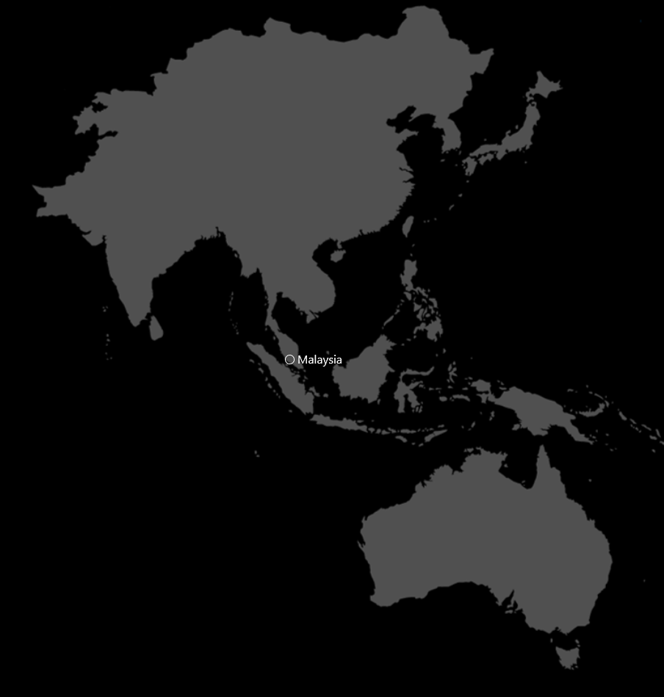
Azure approach to Compliance
Aligned to how Microsoft approaches FSI guidelines in other regions and countries:
Compliance Mapping, to serve as a checklist of Azure services for Malaysia RMIT guideline
Azure Policy, to serve as an architectural baseline, and allows banks to implement additional controls on top of it
Azure Security Center for compliance monitoring, allowing banks to track compliance of Azure resources

Slide 43
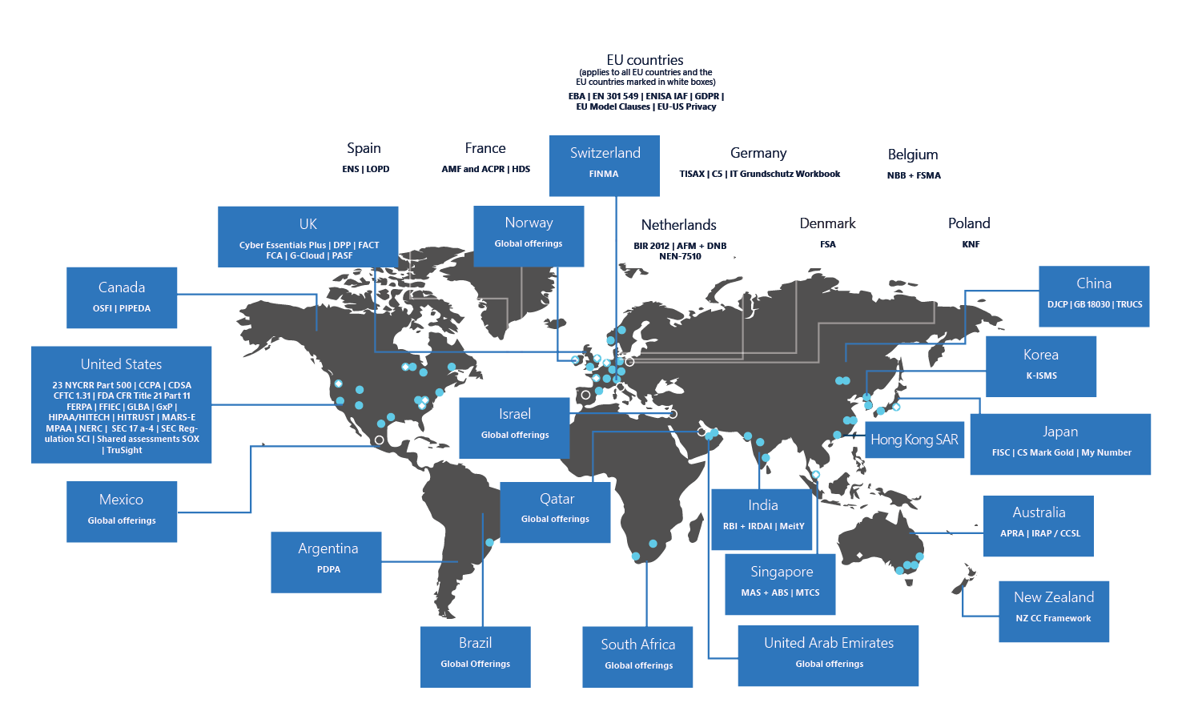
Azure Global Compliance
The following compliance
standards apply globally
CIS Benchmark
CSA-STAR attestation
CSA-STAR certification
CSA-STAR self-assessment
ISO 20000-1:2011
ISO 22301
ISO 27001
ISO 27017
ISO 27018
ISO 27701
ISO 9001
PCI DSS
SOC
WCAG
Azure has more global regions than any other cloud provider—offering the scale needed to bring applications closer to users around the world, preserving data residency, and offering comprehensive compliance and resiliency options for customers.
Over
Available region
Announced region
Availability zones
60
140
https://docs.microsoft.com/en-us/azure/compliance
regions
worldwide
available in
140 countries

Slide 44
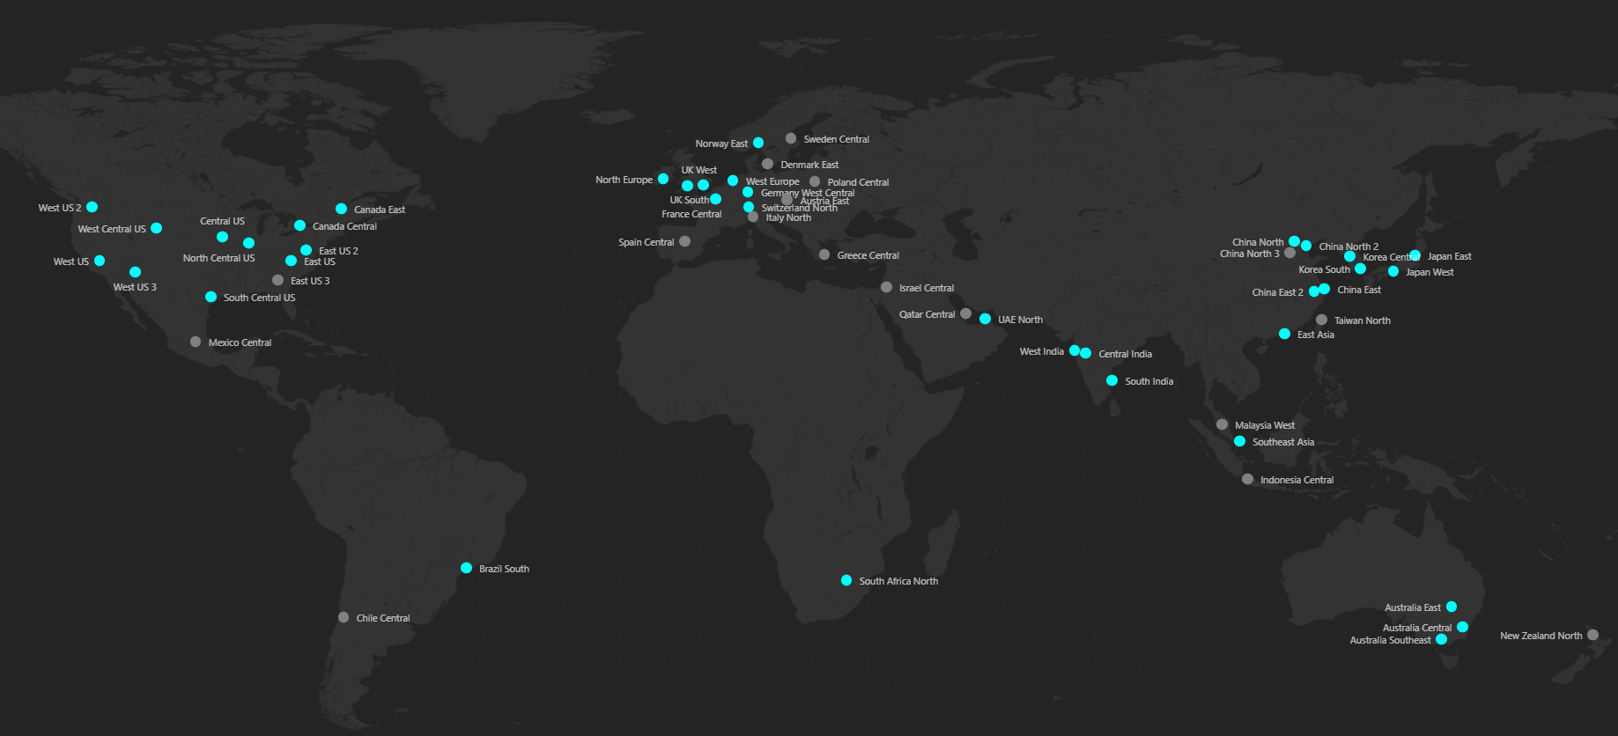
Hybrid
Secure
Compliant
91
Compliance offerings
90+
Compliance
Certifications
GLOBAL
INDUSTRY
REGIONAL
ISO 27001:2013
ISO 27017:2015
ISO 27018:2014
ISO 22301:2012
ISO 9001:2015
ISO 20000-1:2011
SOC 1 Type 2
SOC 2 Type 2
SOC 3
CIS Benchmark
CSA STAR Certification
CSA STAR Attestation
CSA STAR Self-Assessment
WCAG 2.0 (ISO 40500:2012)
Argentina PDPA
Australia IRAP Unclassified
Australia IRAP PROTECTED
Canada Privacy Laws
China GB 18030:2005
China DJCP (MLPS) Level 3
China TRUCS / CCCPPF
EU EN 301 549
EU ENISA IAF
EU Model Clauses
EU – US Privacy Shield
GDPR
Germany C5
Germany IT-Grundschutz workbook
India MeitY
Japan CS Mark Gold
Japan My Number Act
Netherlands BIR 2012
New Zealand Gov CIO Framework
Singapore MTCS Level 3
Spain ENS High
Spain DPA
UK Cyber Essentials Plus
UK G-Cloud
UK PASF
PCI DSS Level 1
GLBA (US)
FFIEC (US)
Shared Assessments (US)
SEC 17a-4 (US)
CFTC 1.31 (US)
FINRA 4511 (US)
SOX (US)
23 NYCRR 500 (US)
OSFI (Canada)
FCA + PRA (UK)
APRA (Australia)
FINMA (Switzerland)
FSA (Denmark)
RBI + IRDAI (India)
MAS + ABS (Singapore)
NBB + FSMA (Belgium)
AFM + DNB (Netherlands)
AMF + ACPR (France)
KNF (Poland)
European Banking Authority (EBA)
FISC (Japan)
HIPAA BAA (US)
HITRUST Certification
GxP (FDA 21 CFR Part 11)
MARS-E (US)
NHS IG Toolkit (UK)
NEN 7510:2011 (Netherlands)
FERPA (US)
CDSA
MPAA (US)
FACT (UK)
DPP (UK)
66
Microsoft Cyber Defense Operations Center
>3,500 full-time security professionals
6.5 trillion global signals daily
$1 billion annual cybersecurity investment
Azure regions
Largest geographical footprint of any cloud provider operating regions in 28 countries on all continents.
Seamless integration and common management of resources across heterogenous and hybrid environments
U.S. GOVT
FedRAMP High
FedRAMP Moderate
EAR
ITAR
DoD DISA SRG Level 5
DoD DISA SRG Level 4
DoD DISA SRG Level 2
DFARS
DoE 10 CFR Part 810
NIST SP 800-171
NIST CSF
Section 508 VPATs
FIPS 140-2
CJIS
IRS 1075
CNSSI 1253
https://infrastructuremap.microsoft.com
Notes:
Hybrid – largest geographical footprint of any cloud provider with more than 60 Azure regions
Secure – ss
Compliant – 90 plus compliance certifications

Slide 45
A secure foundation at global scale
Secured with cutting-edge operational security
Restricted access
24x7 monitoring
Global security experts
Each physical datacenter is protected with world-class, multilayered protection.
Over 100 datacenters across the planet
Global cloud infrastructure with custom hardware and network protection
$1B+ USD investment in security R&D and 3,500 cyber security experts
Notes:
Physical security. Strong protections for the physical datacenter, access requires moving through multiple physical layers and provide multiple forms of identification.
Operational security. We have a big focus on red team, blue team exercises. If you're not familiar with those, the idea is that we have dedicated professionals whose job it is to be on the good side but act like the bad guys—they’re constantly trying to find ways to penetrate the services and find ways that hackers might attack us so that we can shore up our defenses.
Global cloud infrastructure – hardened with multiple layers or protection
$1B investment – we spend heavily on security, because we want to keep ahead of the latest attack, which is why we have over 3,500 cybersecurity experts

Slide 46

Compliance depth within regulated industries
Financial Services
Microsoft offers a dedicated and comprehensive FSI compliance program streamlining compliance workflow with right to audit, automated audits, and self-reporting.
Notes:
To help firms comply with both national and regional regulated industry requirements, Microsoft provides a set of compliance offerings:
Finance - Microsoft offers the Financial Services Compliance Program specifically to help financial institutions identity, assess, and manage risk, as well as support for financial standards including 23 NYCRR, AFM+DNB, AMF+CPR, APRA, CFTC 1.31, EBA, FCA, FFIEC, FINMA, FINRA, FISC, FSA, GLBA, KNF, MAS+ABS, OFSI, PCI DSS, RBI+IRDAI, SEC 17a-4, and SOX.
Health - Azure is built for the requirements of handling sensitive health data, including offering a HIPAA Business Associate Agreement (BAA), and compliance with HITRUST, MARS-E, NEN-7510, and NHS IG.
Government - Azure Government offers unparalleled flexibility and breakthrough innovation for US government agencies and their partners, along with compliance for CJIS, DoD, DoE, EAR, FedRAMP, FIPS, IRS 1075, ITAR, NIST 800-171, NIST CSF, and Section 508 VPATS
Media - Azure helps protect the integrity of media assets through comprehensive compliance, including CDSA, DPP, FACT, MPAA

